Slide 1
NBA STATS
Eddy Alexandre
IS 296
Prof.Chen
S13_NBA_playoffs

Slide 2
Mini #1
INTRO/OVERVIEW
My presentation focuses on trends in NBA playoffs from the 2021–2022 season. I will examine the relationships between different stats in my data. I will examine shots taken and free throws taken. I will also examine player positions and their performance . The shots taken by guards vs by forwards location on court. Interesting stats that are bizarre but on trend for the NBA

Slide 3
Gaols: to help casual fans have a better insight on the actual stats of the game.
Audience: basketball fans, analysts, and bettors who are seeking deeper insights into player performance and statistical trends.
Mini #1
Goals/ Audience

Slide 4
Are high performers playing all 4 quarters?
Does more 3 point attempts lead to lower or higher field goal%?
Do guards shoot more midranges then forwards ?
How do points, assists, rebounds, steals differ by position?
Do the teams who shoot the most 3s average the most rebounds?
Mini # 1
Questions?

Slide 5
DATA Profile
Data profile
217 rows. 30 columns. 30 columns listed below (grouped by type).
Column(s) | Missing? | Data Type | Useful? | Need Cleaning?
Player, Pos | No | Categorical/Text | Yes – needed to compare guards vs forwards/centers | Standardize positions
MP (Minutes Played) | No | Numeric | Yes – helps determine if top players play more | No
FGA, FG% | No | Numeric | Yes – analyzes shot volume vs efficiency | No
3PA, 3P% | No | Numeric | Yes – answers impact of 3-point shooting | No
TRB (Rebounds) | No | Numeric | Yes – connects shooting trends to rebounding | No
AST, STL, PTS | No | Numeric | Yes – shows overall performance differences by position | No

Slide 6
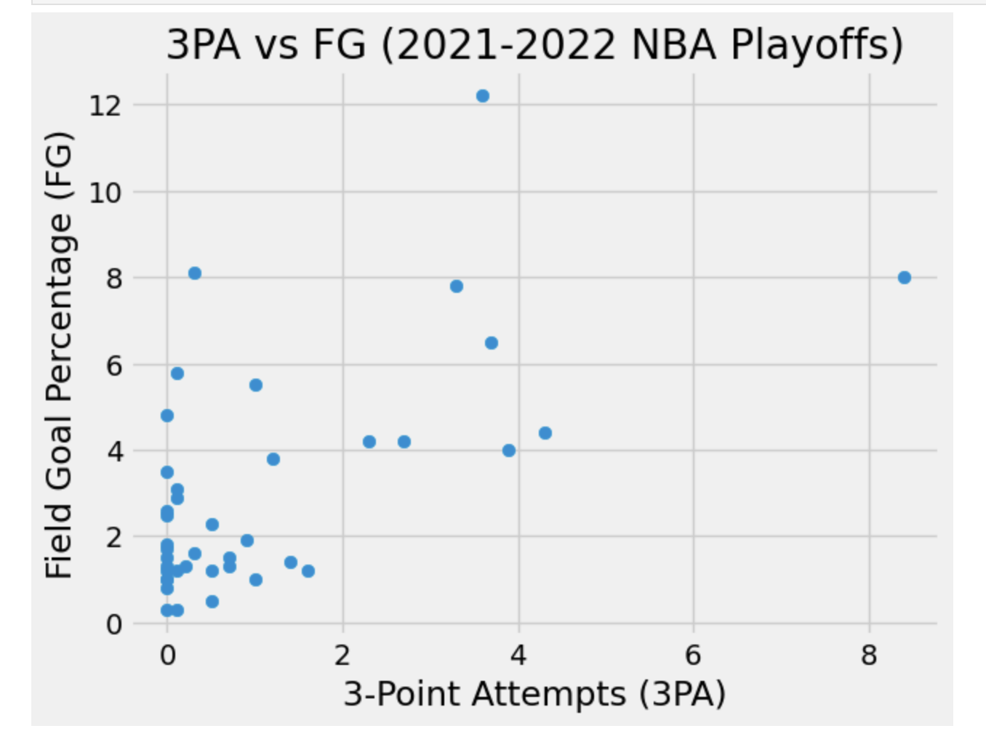
This analysis explores whether taking more three-point shots impacts overall shooting efficiency. The data shows that players with higher three-point attempts tend to have slightly lower field goal percentages. This is likely because three-point shots are more difficult than midrange or inside shots. However, despite the lower efficiency, players continue to take more threes because of the higher point value, reflecting a modern NBA trend focused on spacing and scoring efficiency.
Insight 1 - Do More 3-Point Attempts Affect Field Goal %?

Slide 7
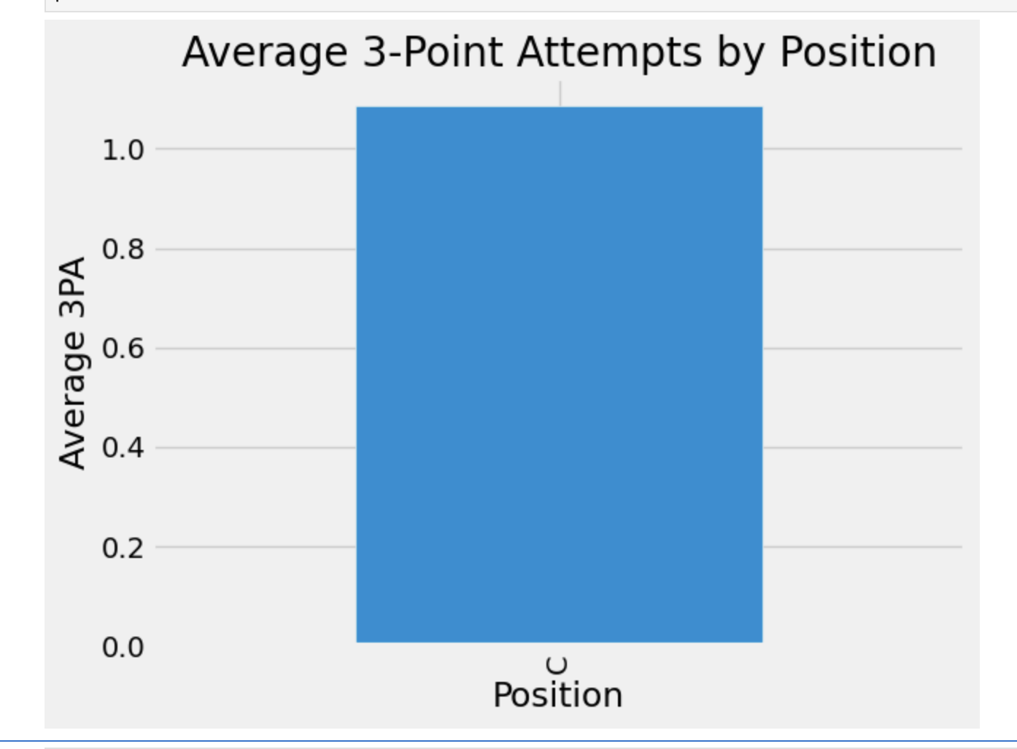
This insight compares shot selection between guards and forwards. The data shows that guards take significantly more three-point shots compared to forwards. This reflects their role as perimeter players who handle the ball and create offense from outside. In contrast, forwards tend to take fewer threes and operate closer to the basket. This highlights how position strongly influences shot location and playing style in the NBA.
Insight 2- Do Guards Shoot Differently Than Forwards?

Slide 8
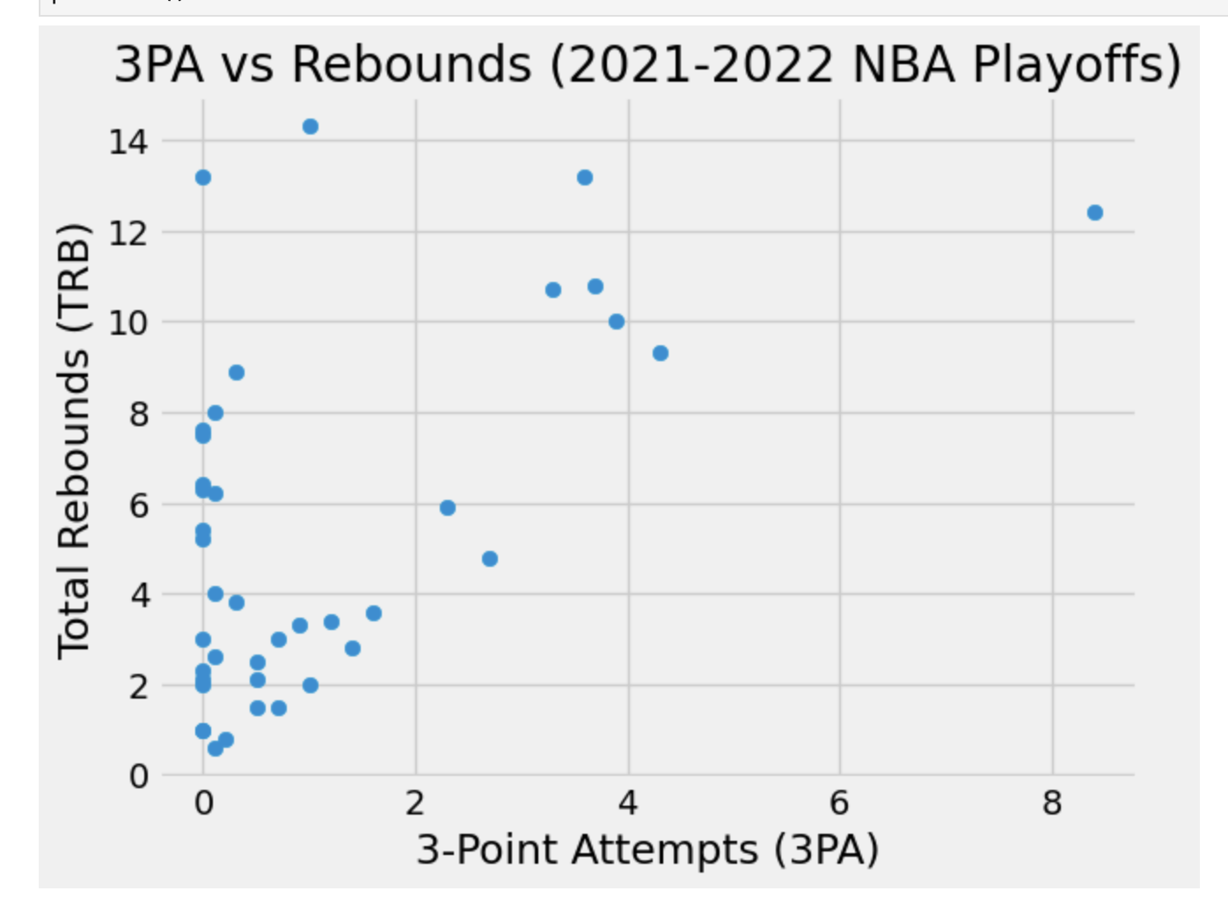
Insight 3- Do Teams That Shoot More 3s Get More Rebounds?
This analysis examines whether increased three-point shooting leads to more rebound opportunities. The data suggests a slight positive relationship between three-point attempts and rebounds. This may be because missed three-point shots often result in longer rebounds, creating more chances for players to grab the ball. This trend supports the idea that changes in shooting style can influence other aspects of the game, such as rebounding.

Slide 9
What I worked on: Cleaned NBA playoff dataset, created charts/tables, and developed 2–3 key insights for presentation
Obstacles: Dealing with missing/inconsistent data, choosing meaningful insights, fixing Python charting errors
Resources used: Python (pandas, matplotlib), class notes, NBA stats websites for context, youtube for debugging
Progress check

